Slide 1

INSTITUTE: UIE (AIT-CSE)
Computer Networks CST- 335
Tunnelling and Fragmentation
By : Dr. Monica Luthra(E9836)
DISCOVER . LEARN . EMPOWER

Slide 2

Course Objectives
CO Number | Title
CO1 | Describe the important networking concepts
CO2 | Understand concept of network reference models and protocols
CO3 | Apply the concepts of routing algorithms on various networks
CO4 | Identify mechanism to handle traffic and control on congestion
CO5 | Identify and understand connection establishment techniques and features

Slide 3

Course Outcomes
After this course student will be able to:
To bring together several key of Computer network design and architecture
To Familiarize the student with the basic taxonomy and terminology of the computer networking area.
To Allow the student to gain expertise in some specific areas of networking such as the design and maintenance of individual networks.

Slide 4

Contents
Internetworking: styles
Tunnelling
Fragmentation

Slide 5
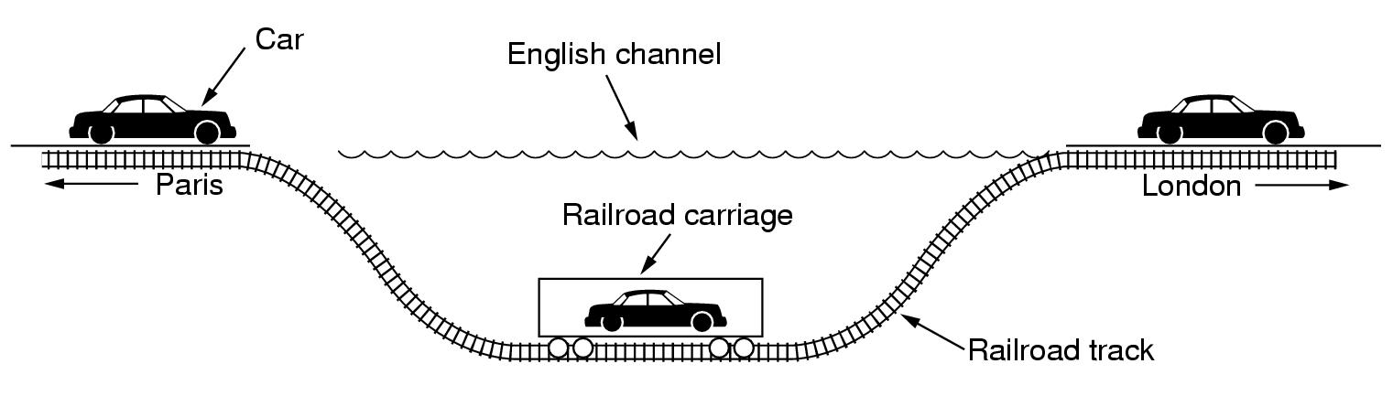
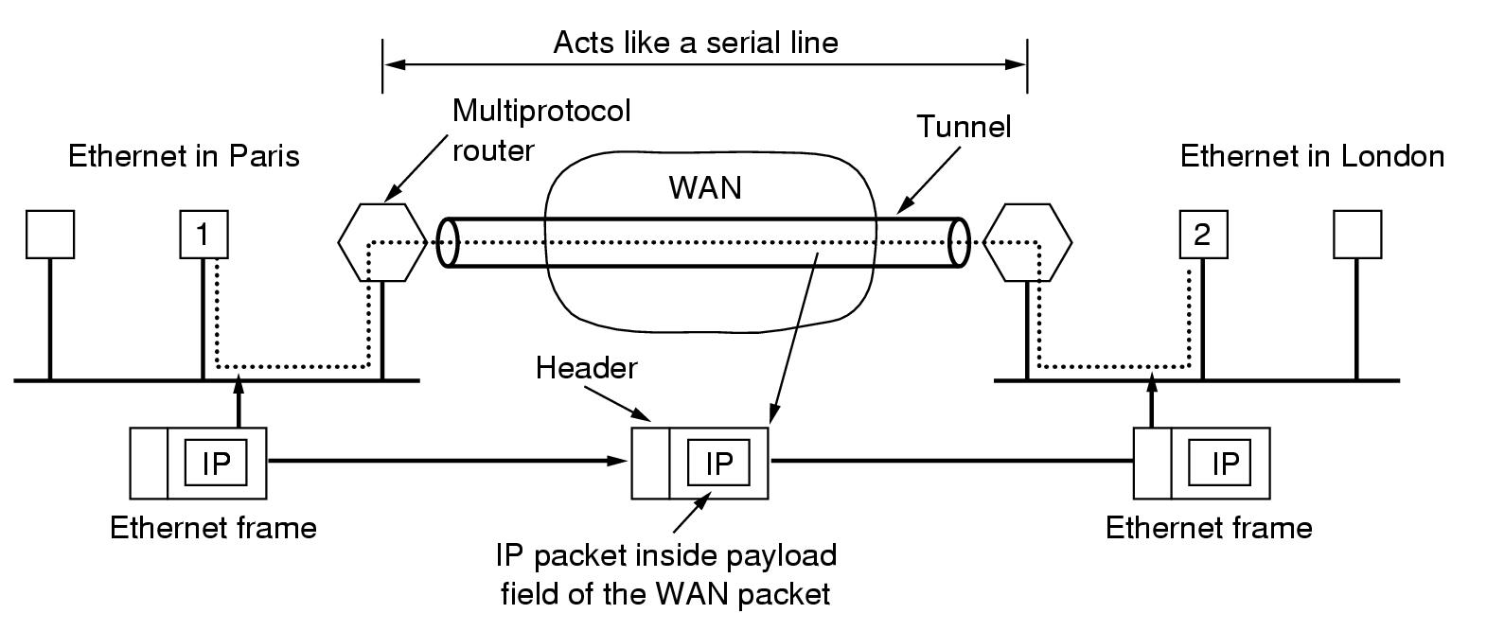
Internetworking: styles
Tunneling
Interconnect 2 identical networks using a different one
Behaviour: point-to-point line between multiprotocol routers

Slide 6
Tunneling is an internetworking staretgy tht is used when source and destination network of same type are connected through other network viaa different kind of network that interconnects them.
To understand tunneling let an ethernet is to be connected to another via WAN .

Slide 7
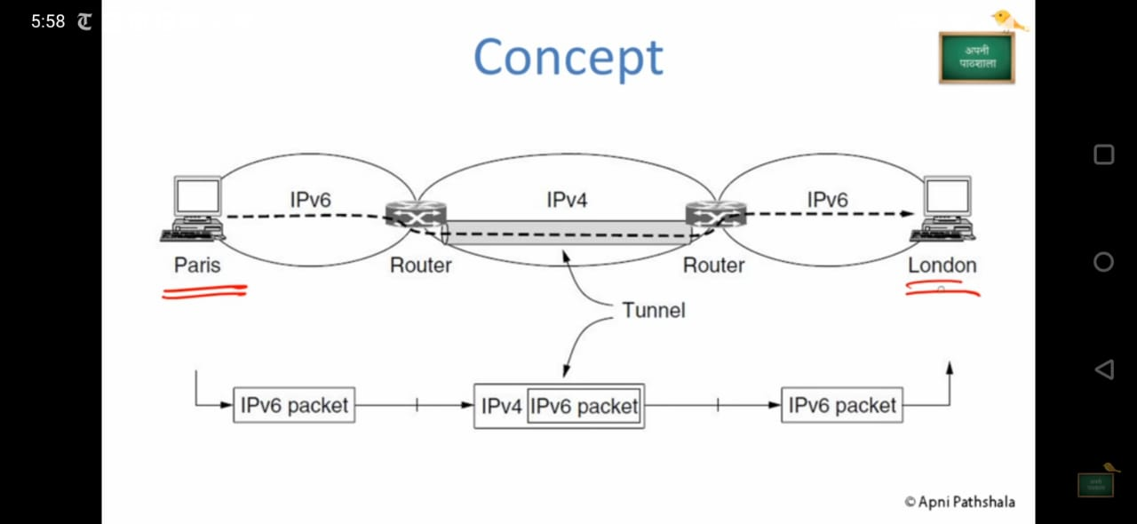

Slide 8
Internetworking: routing
Same problem + some complications
2 levels of routing:
Within a network
Intranetwork routing
Interior gateway protocol
Internetwork routing
Graph construction
Every router can directly access routers on the same network
Packet forwarding + tunneling if necessary
Differences with intranetwork routing
Cross international boundaries adopt national laws
Agreements between operators (transit traffic)
Between networks
Internetwork routing
Exterior gateway protocol

Slide 9
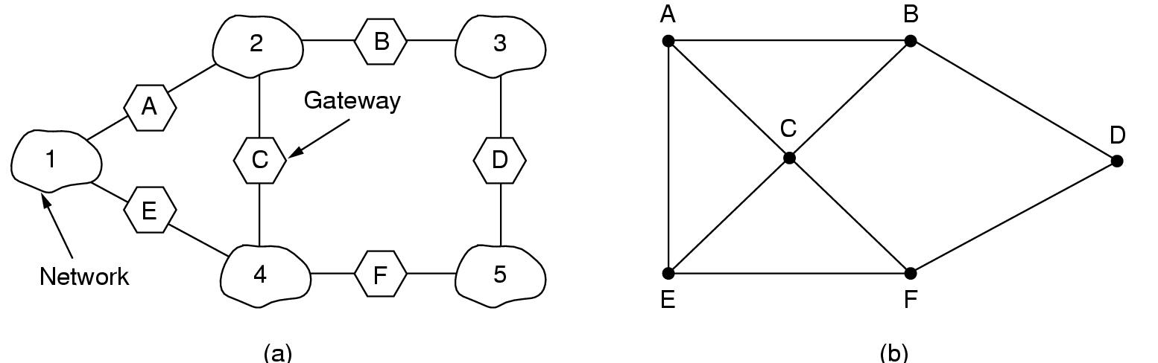
Internetworking: routing
An internetwork:
Router A can communicate with routers B and C
Graph of internetwork

Slide 10
Fragmentation
As datagrams move from source to destination , they travel through different networks to reach their destination.
Each network imposes some maximum size restrictionss on its packet.Thus network designers are not free to choose any maximum packet size they wish.
The maximum packet size varies from network to network.

Slide 11
Internetworking: fragmentation
Problem: Large packet through network with smaller maximum packet size
Solution:
Break large packet into fragments
Send each fragment as a separate packet
Reassemble: transparent <> non transparent?
Transparent fragmentation
Strategy
Gateway breaks large packet into fragments
Each fragment addressed to same exit gateway
Exit gateway does reassembly

Slide 12
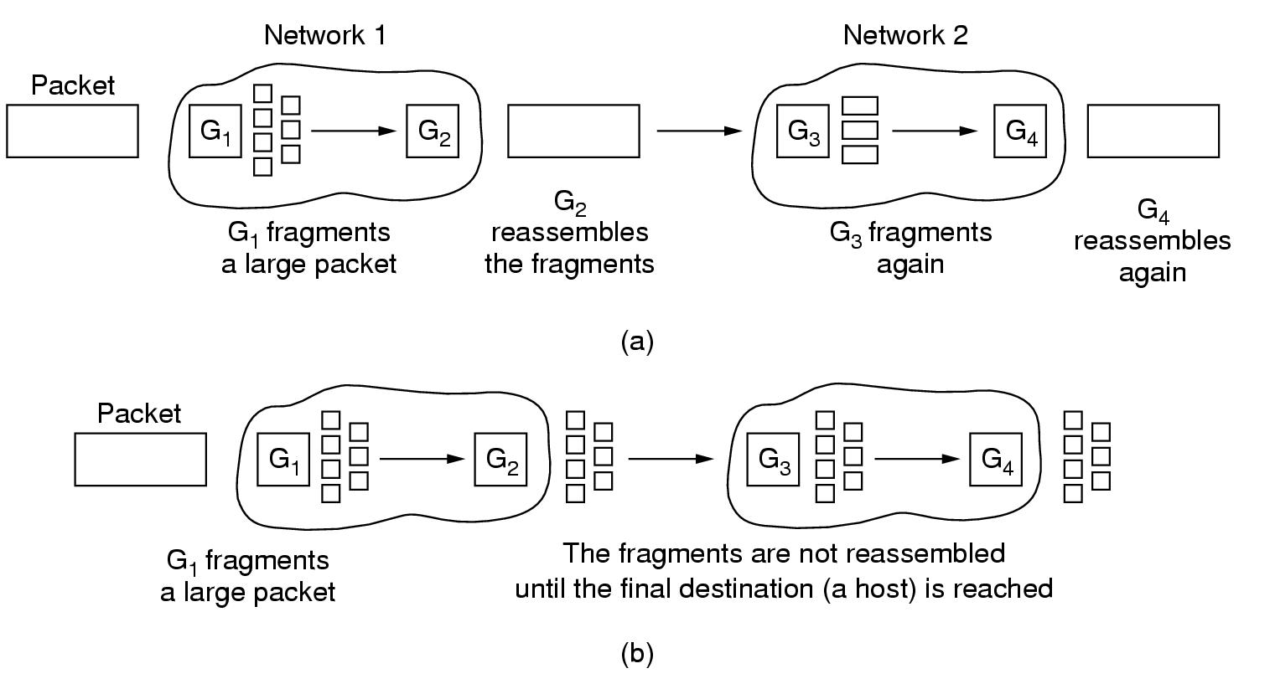
Internetworking: fragmentation
Transparent fragmentation
Strategy
Gateway breaks large packet into fragments
Each fragment addressed to same exit gateway
Exit gateway does reassembly
Simple, but some problems
Gateway must know when it has all pieces
Performance loss: all fragments through same gateway
Overhead: repeatedly reassemble and refragment
Example: ATM segmentation

Slide 13
Internetworking: fragmentation
Nontransparent fragmentation
Strategy
Gateway breaks large packet into fragments
Each fragment is forwarded to destination
problems
Every host must be able to reassembly
More headers
Example: IP fragmentation

Slide 14
References
https://www.geeksforgeeks.org/introduction-of-internetworking
https://www.computernetworkingnotes.com/ccna-study-guide/internetworking-in-computer-network.html
https://ecomputernotes.com/computernetworkingnotes/computer-network/what-is-internetworking

Slide 15
THANK YOU
For queries
Email: monica.e9836@cumail.com

